Slide 1
Supporting Reuse
With Aspects
CDI, Software Product Lines and Apect-Oriented Change Realization

Slide 2
Software Component
Software component is unit of composition with explicitly determined (approval) and required interfaces and dependencies. Similarly, it can be independently deployed and is subject of composition performed by third parties. Component has no externally observable state.
Source: SZYPERSKI, Clemens, 2002. Component Software : Beyond
Object-Oriented Programming. ISBN 0-201-745572-0.
GOOD TO ACHIEVE REUSE?

Slide 3
Composition Of Components
Aspects
SOA
Services are composed based on
on Loose coupling
Aspects are composed with
the rest of the code
Implementational level
Architectural level
Microservices
Micro-frontend
Using orchestrator like
Docker Swarm or Kubernetes
Architectural level

Slide 4
Domain Knowledge
Timeless compression of mental models of end users and other stakeholders
Mental models whose patterns are tacidly
driven by commonality and variation
Source: James O. Coplien and Gertrud Bjrnvig. 2010.
Lean Architecture: for Agile Software Development. Wiley Publishing.

Slide 5
Introducing Software Product Lines
Evolutionary
Revolutionary
Existing Set of Products
New Set of Products

Slide 6
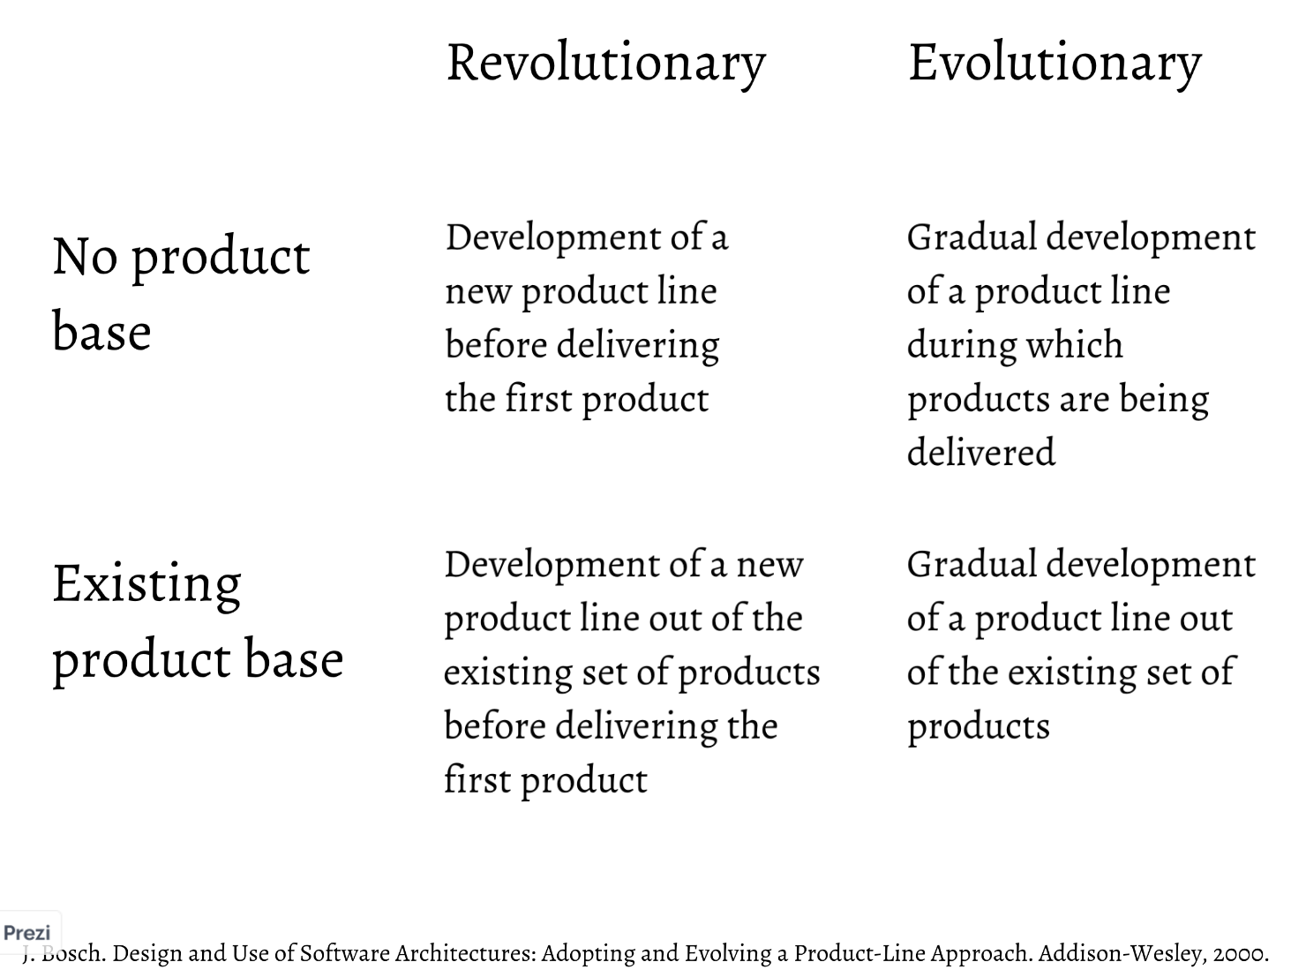
Source: https://poetisania.com/val/aosd/index.html

Slide 7
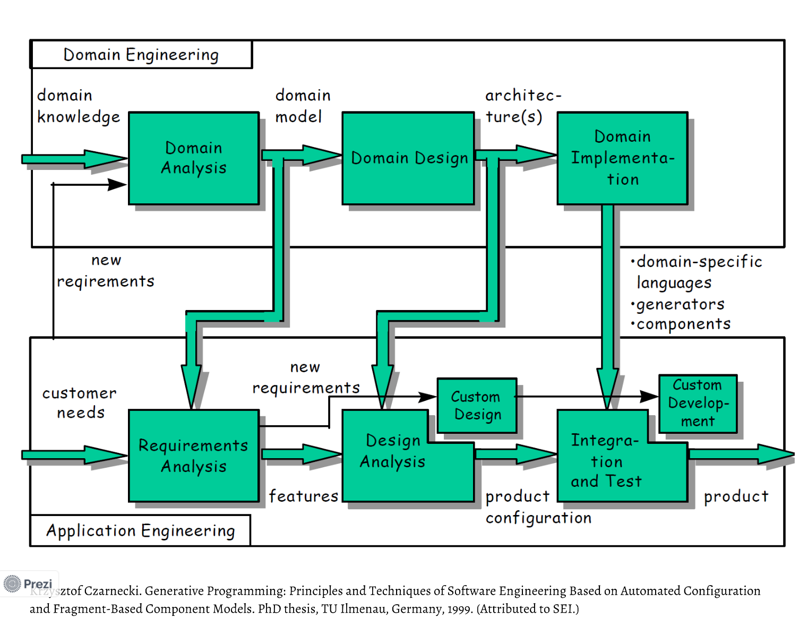

Slide 8
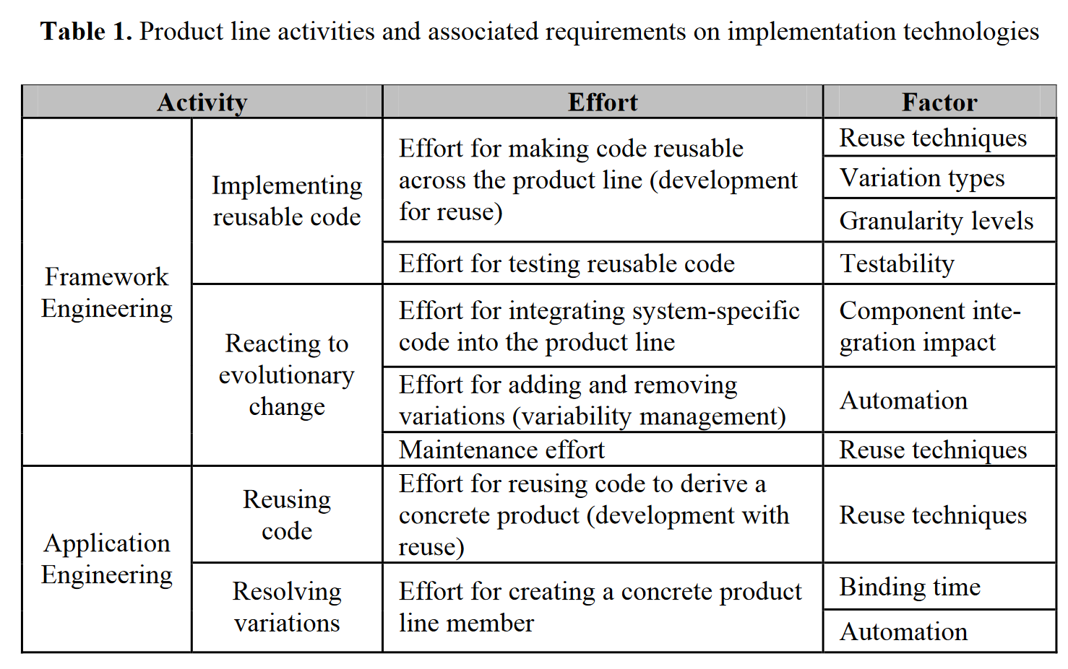
Source: Anastasopoulos, M. and Muthig, D. (2004) ‘An Evaluation of Aspect-Oriented Programming as a Product Line Implementation Technology’, in J. Bosch and C. Krueger (eds) Software Reuse: Methods, Techniques, and Tools. Berlin, Heidelberg: Springer Berlin Heidelberg, pp. 141–156.

Slide 9
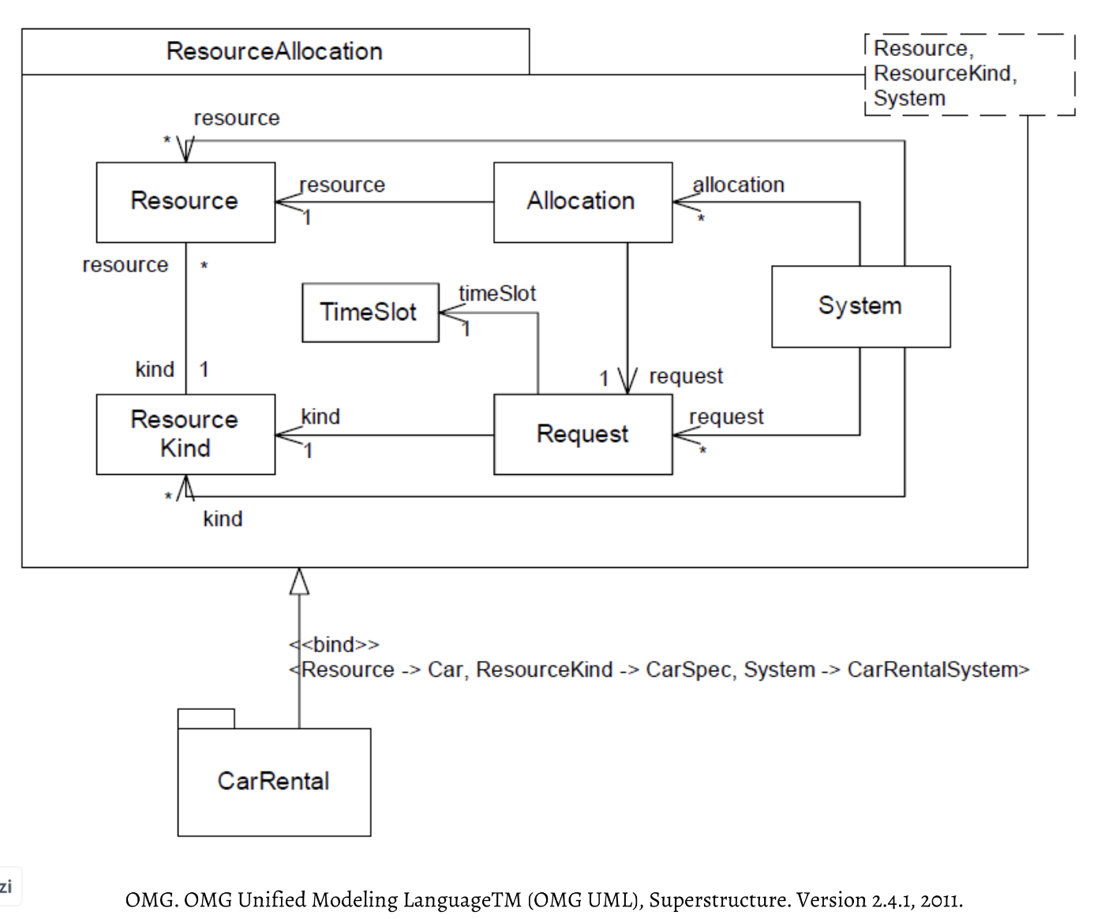

Slide 10
Use of ECaesarJ
Why?
Insufficient
mechanisms in OOP
for modularizing the
features
PROVIDES LARGE-SCALE SELECTION AND COMPOSITION MECHANISMS
Only for individual
objects/classes
VIRTUAL CLASSES
PROPAGATING THE
MIXIN COMPOSITION
-inner classes
-late-bound instantiation
Multiple affected
objects/classes
by Features
Composition propagates
into virtual classes
-can be refined in subclasses
of enclosing class
ALL INHERITED DECLARATIONS
OF VIRTUAL CLASSES
WITH THE SAME NAME ARE MERGED
AUTOMATICALLY
-as family members
– members of instances of
the enclosing class [family objects/classes]
Large-scale
extension
mechanism

Slide 11
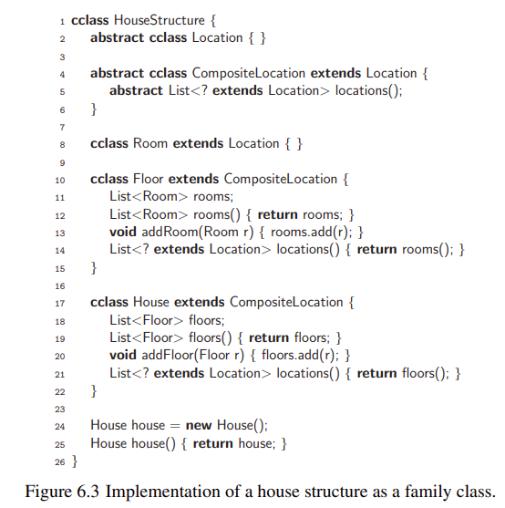
Implementation
in ECaesarJ
Feature
In family class
feature-oriented
modularization of
software product lines
To not confuse this with Java class
-to use it as extension ofJava
Domain
objects
cclass
In virtual
classes
New CaesarJ dat structure
Taken from: Rashid, A., Royer, J.C., Rummler, A. (eds.):
Aspect-Oriented, Model-Driven Software Product Lines:
The AMPLE Way (09 2011)

Slide 12
The DCI Architecture:
A New Vision of Object-Oriented Programming
- Vision to capture the end user cognitive model
Model of roles and interaction between these roles
- A way how to combine roles, algorithms, objects, and associations between them to provide a stronger mapping between the code and the end-user mental model
Objects capture structure, but fail to capture system action
Source: https://www.artima.com/articles/the-dci-architecture-a-new-vision-of-object-oriented-programming

Slide 13
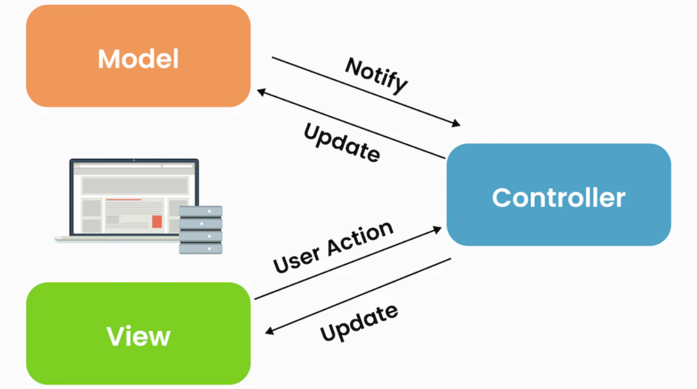
MVC
Not just any composition of Observer pattern
Source: https://www.linkedin.com/pulse/model-view-controller-architecture-programming-aditira-jamhuri

Slide 14
MVC
Not just any composition of Observer pattern
Defines interaction between the objects that play them
Roles
Model-View-Controller
Perspective
Source: https://www.linkedin.com/pulse/model-view-controller-architecture-programming-aditira-jamhuri

Slide 15
MVC
Not just any composition of Observer pattern
MVC-U
The way how to separate
the representation of information
from user interaction
CAPACITY:
Model-View-Controller-User
Source: https://www.linkedin.com/pulse/model-view-controller-architecture-programming-aditira-jamhuri

Slide 16
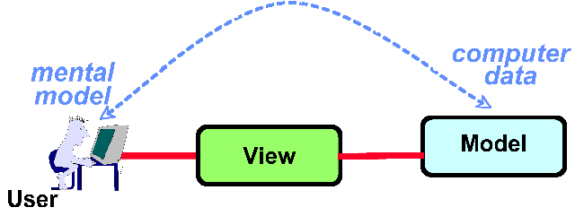
Interpretation of data:
MVC-U
Information
Key element in end
user mental model
The aim of good program:
capturing the information model
in the data model
Data
Staff in User Head
-representation of information
-in computers: bits
-meaning in user head: interaction between bits
Union of cognitive model and data model
Direct manipulation
metaphor:
the sense that end users are actually manipulating objects in memory that reflect the images in their head
Source: https://www.artima.com/articles/the-dci-architecture-a-new-vision-of-object-oriented-programming

Slide 17
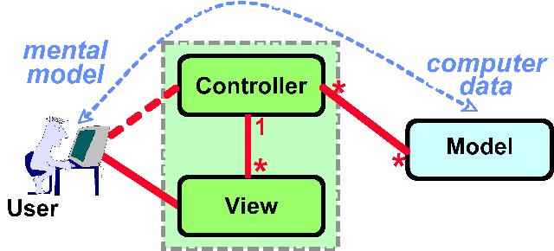
Direct Manipulation Metaphor
Raw
Data
Simple Cognitive Models
Model
Filters the data
The Controller creates Views
and coordinates Views and Models.
CAPACITY:
Model-View-Controller-User
Source: https://www.artima.com/articles/the-dci-architecture-a-new-vision-of-object-oriented-programming

Slide 18
Raw Data
Simple Cognitive Models
Model
Basic building blocks
Filters the data
Example: half-call in telephony domain
Telephone operator: duration, may shrink number of parties
Supported user illusion with model
...
Another actor: sees data differently/ different perspective
Supported user illusion with model
User has a feel that he is
manipulating with real object

Slide 19
Extension by
Derivation
Particularly simplistic rule of thumb
nouns
verbs
objects
methods
Static type
system
Solved by:
Objects are stable
Smalltalk
All code in objects thus cannot
represent a change
class as implementation tool
for object as analysis concept
inheritance graphs as design abstraction
Agile vision of evolution and maintainability
separed
-fully represented by base class interface
Solved by:
Inheritance
stable
Solved by:
Problem of inheritance hierarchies 25 deep
programming by extension
programming by
difference
Supports
open-closed
principle
changeable
newly added methods either
didn't appear in the base class
Notes:
- perspectives of system architecture
- software engineering
- maintenance rate of change

Slide 20
Data
Roles
domain entity class
-behaviors that are about what objects do
- domain classes should be dumb
New concept of an action from users heads
stable data models
dynamic behavioural models
OBJECT
roles embody generic, abstract algorithms
Unifies two models
in users head
weave the algorithms through the roles
WHAT
SYSTEM
IS DATA
MODEL
Interaction
as algorithms
WHAT
SYSTEM
DOES
ALGORITHM
MODEL
- mirrors from the user's mind into the code
- data with their own vocabulary and rules
Static behaviour –
for thinking
Dynamic behaviour

Slide 21
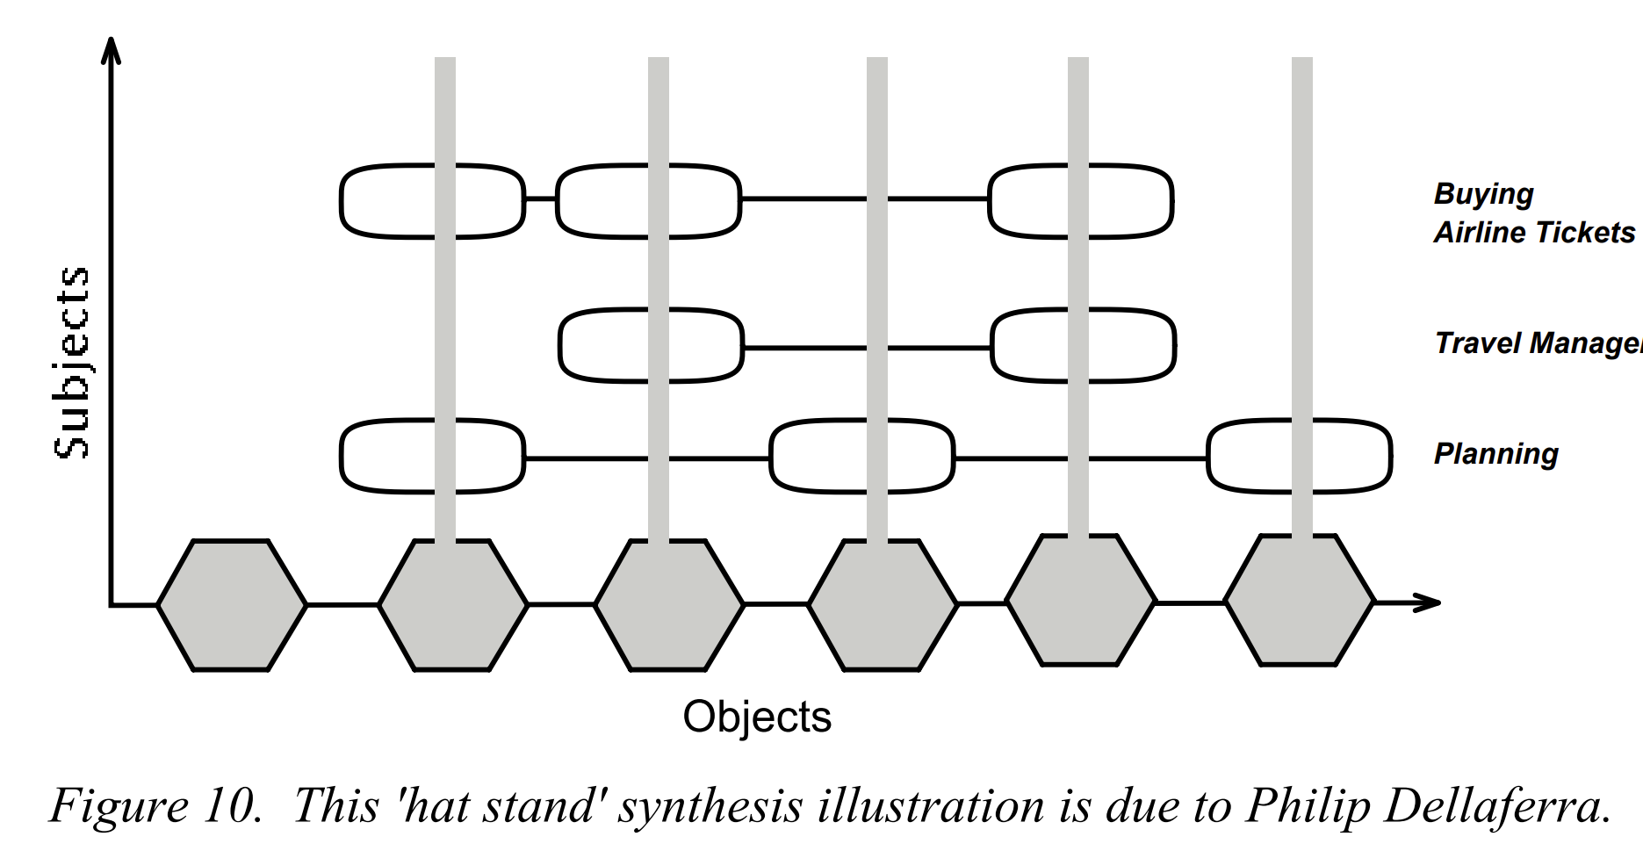
Role Model Synthesis
Object-Oriented Role Analysis Modeling
As role
models
Role in one model plays
environment role in another
models
Each plays one or more roles
Source: Reenskaug, Trygve; P. Wold; O. A. Lehne (1996). Working with Objects: The OOram Software Engineering Method. Manning/Prentice Hall.

Slide 22
What
System is?
What
System Does?
Single user perspective
All users perspective
The Mental Model
of End User
Domain Knowledge
Objects
Roles
Interaction of Roles
Domain Analysis
Use Case Modeling
Source: https://poetisania.com/val/as/index.html

Slide 23
Domain Knowledge
Timeless compression of mental models of end users and other stakeholders
Mental models whose patterns are tacidly
driven by commonality and variation
Source: James O. Coplien and Gertrud Bjrnvig. 2010.
Lean Architecture: for Agile Software Development. Wiley Publishing.

Slide 24
There has been no established
domain knowledge so far?
RELY ON THE END USER COGNITIVE
MODEL OF THE DOMAIN
Create Order
Remove Order
Source: https://poetisania.com/val/as/index.html

Slide 25
There has been no established domain knowledge so far?
RELY ON THE END USER COGNITIVE MODEL OF THE DOMAIN
USE-CASES
Create Order
What System Does
LEAN ARCHITECTURE
What System is
Modify RestockPlan
Remove Order
Source: https://poetisania.com/val/as/index.html

Slide 26
Agile Software Development
USE-CASES preserved in code
Producing only what is neccessary without modyfying an existing functionality
... like stringing corals on a thread
Lean Architecture
Only as much architecture as is neccessary
Avoid producing waste...
Pull, Do not push end users
Making decisions at
responsible moment

Slide 27
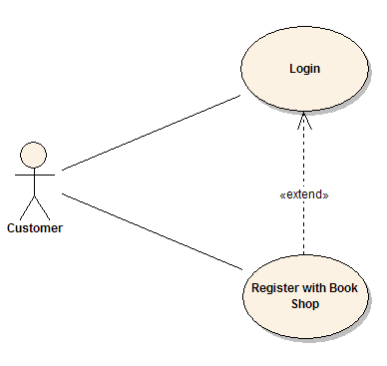
Preserving Aspects in Code
System architecture has to reflect
the end user cognitive model being
able to accommodate emerging use-cases
Use-case modularity problem
Previously unsupported in analytical models and in implementational environments
Jacobson, I., Ng, P.: Aspect-Oriented Software Development with Use Cases.
Addison Wesley Professional (2004), ISBN 0-321-26888-1.

Slide 28
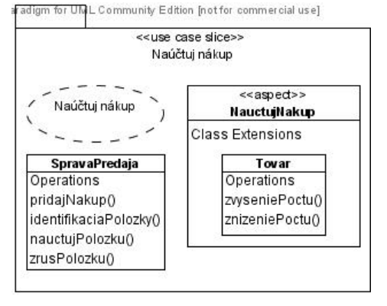
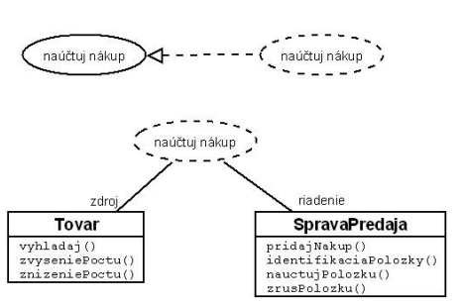
Solution to Peer Use Cases: Intertype Declaration
-we create use case slice…
…containing only specifics for this
use case (Accounting the
` purchase in Figure)
Zdroje z Bc. Pavol Michalco: PRÍPADY POUŽITIA A TÉMY V PRÍSTUPE THEME/DOC

Slide 29
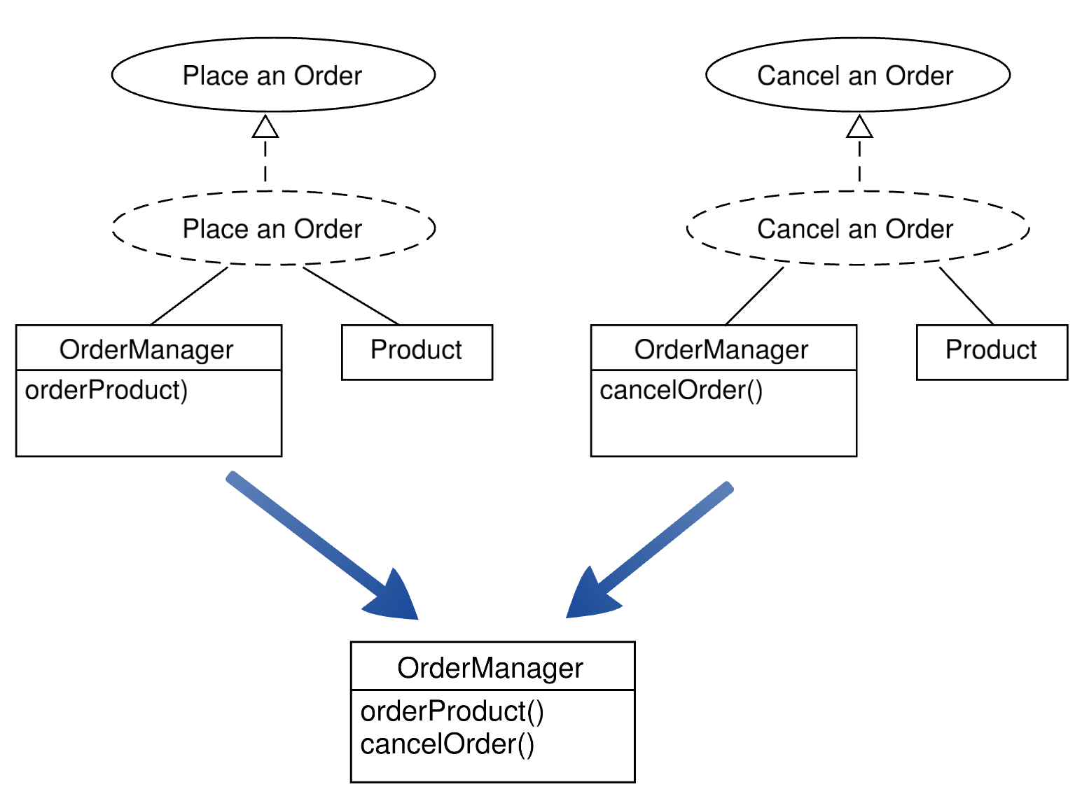
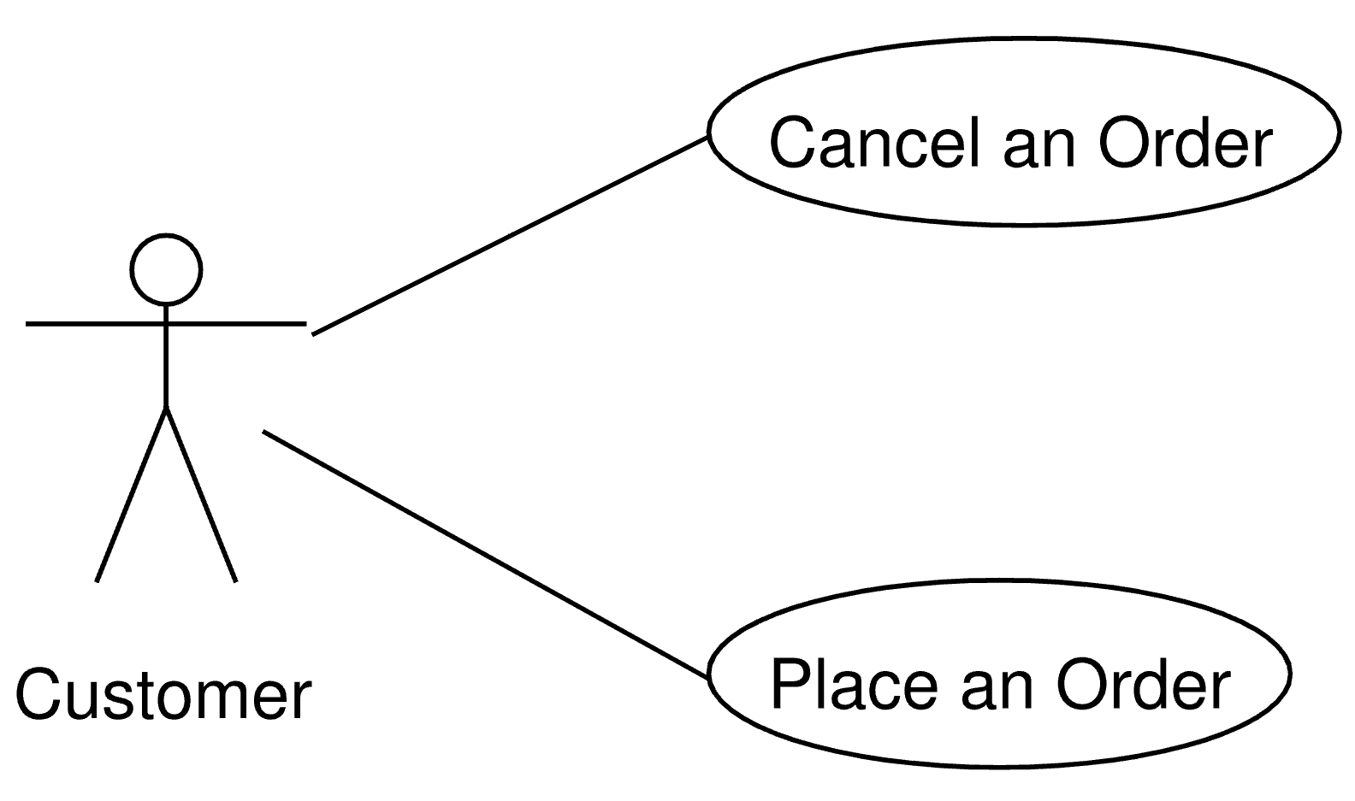
Use case:

Slide 30
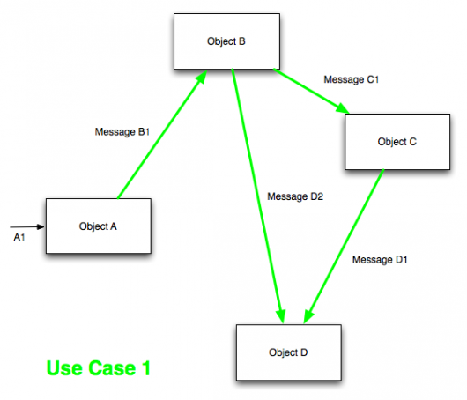
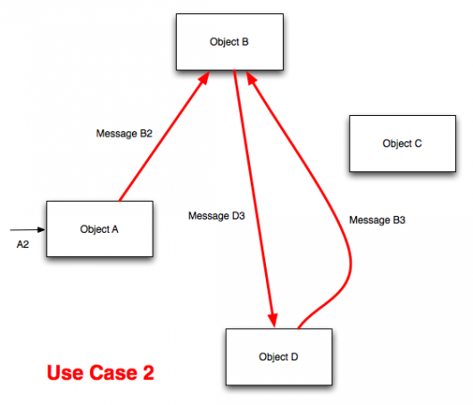
No Representation of System
Operations In Code Using OOP
Source: https://www.sitepoint.com/dci-the-evolution-of-the-object-oriented-paradigm/

Slide 31
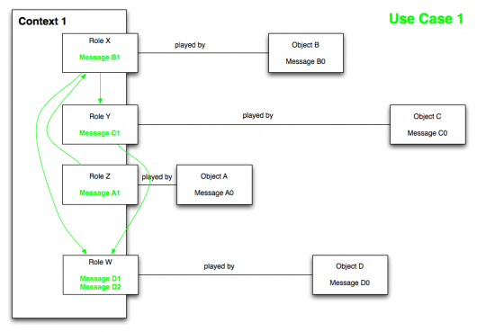
Source: https://www.sitepoint.com/dci-
the-evolution-of-the-object-oriented-paradigm/

Slide 32
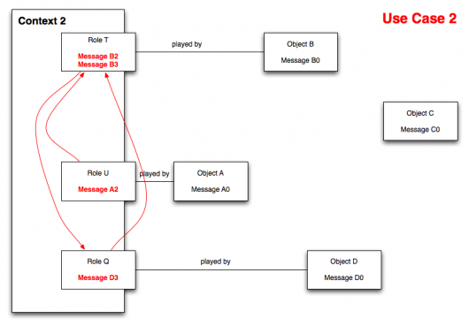
Source: https://www.sitepoint.com/dci-
the-evolution-of-the-object-oriented-paradigm/

Slide 33
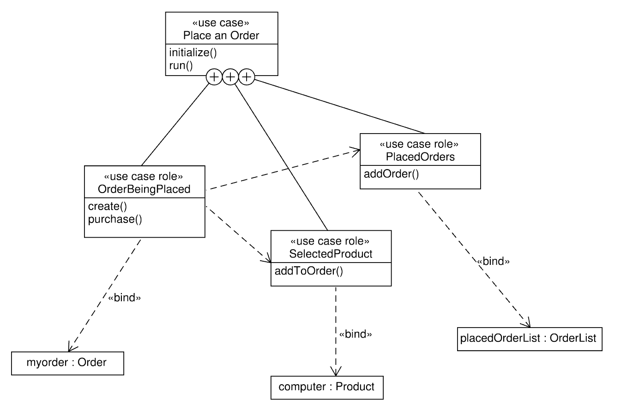
DCI – Data Context
Interaction
-invented by Trygve Reenskaug
Source: https://poetisania.com/val/aosd/index.html

Slide 34
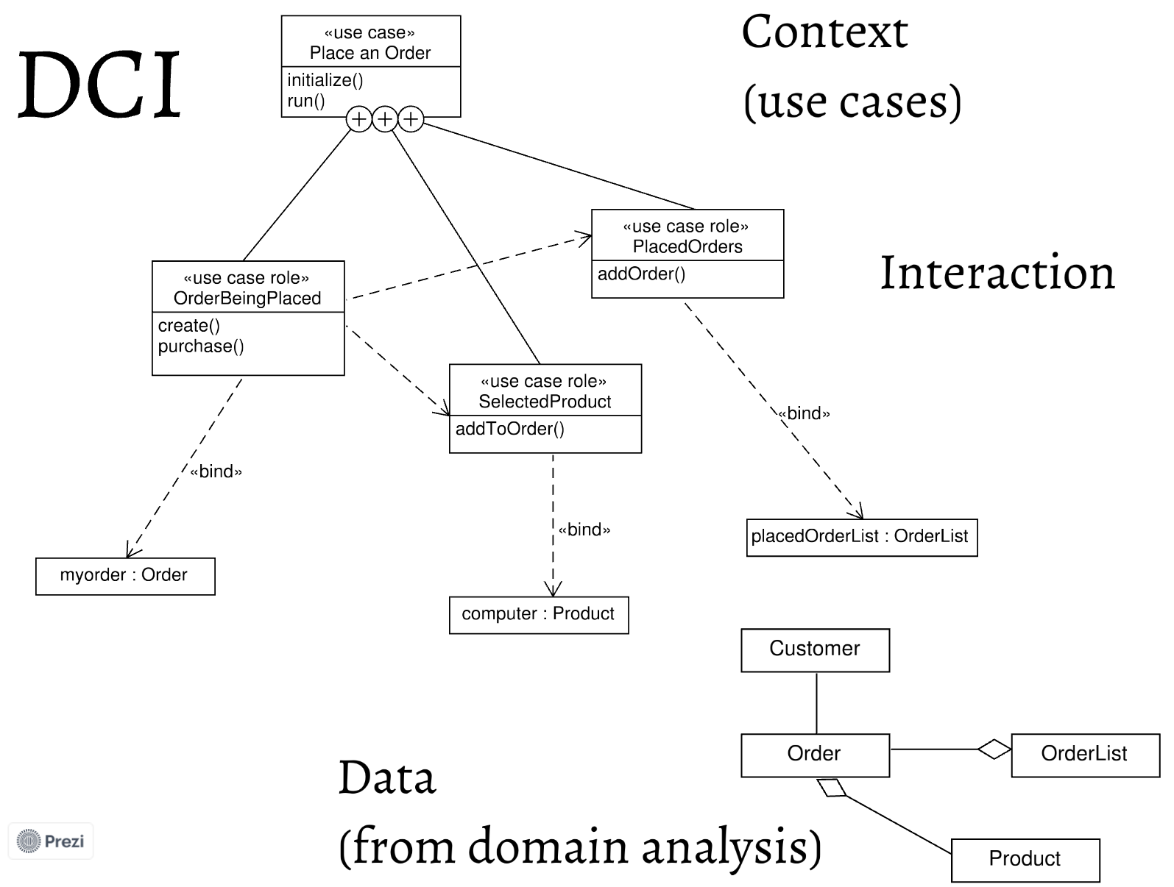
Source: https://poetisania.com/val/aosd/index.html

Slide 35
Data
DCI Class
Interaction
-expresses exclusively
object inner functionality
(not concerning neighbor objects)
- ”What the system is”
LOCALITY
-a data and associated local methods
-each use case in
separate file
SEPARATION TOWARDS
STABLE SOFTWARE
Source code matches
the runtime
-which values are assigned to particular entities
Context
=> Observable from the context
- ”What the system does”
DCI Context
-contextual behavior - only methods which occur in use case
FOCUS
-expresses only communication between objects
IS CHANGING RAPIDLY

Slide 36
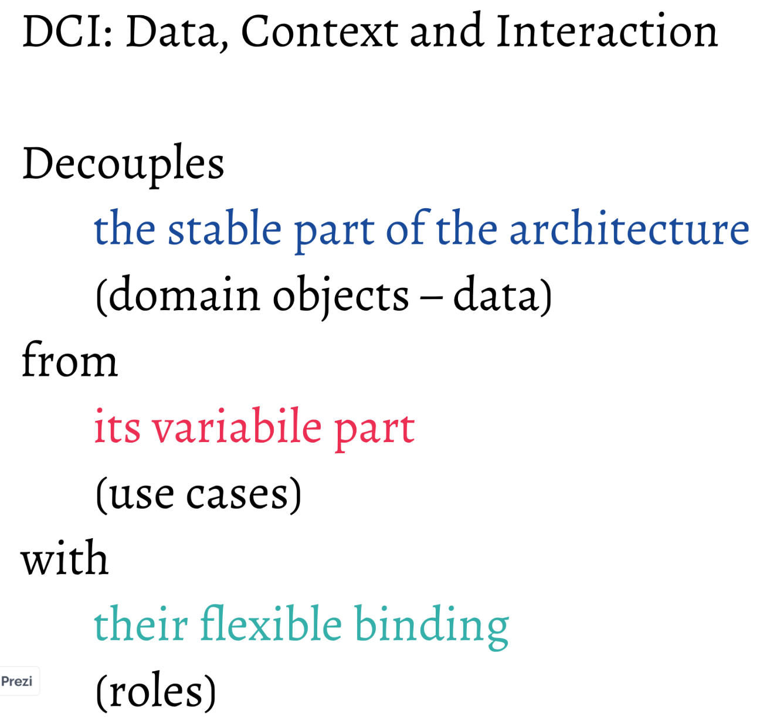
Source: https://poetisania.com/val/aosd/index.html

Slide 37
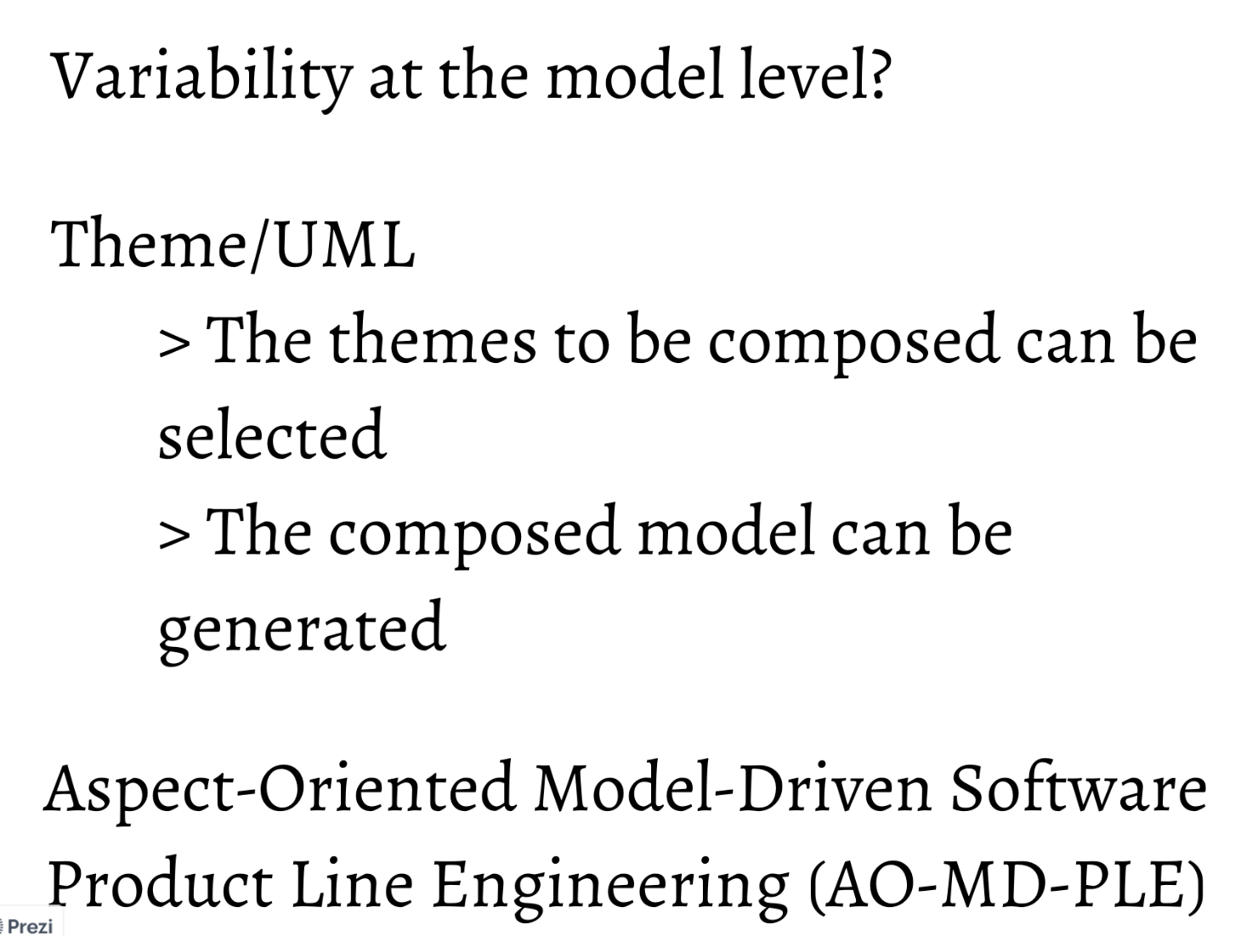
Source: https://poetisania.com/val/aosd/index.html

Slide 38
Aspect-Oriented Change Realization
CHANGE AS CROSSCUTTING REQUIREMENS
Change
-initiated by a change request made by stakeholder (user,…)
Change request
-usually focused on changes to be realized
-containing even interrelated requirements
- has to be split into individual changes, their generalization
and aggregation according to particular domain

Slide 39
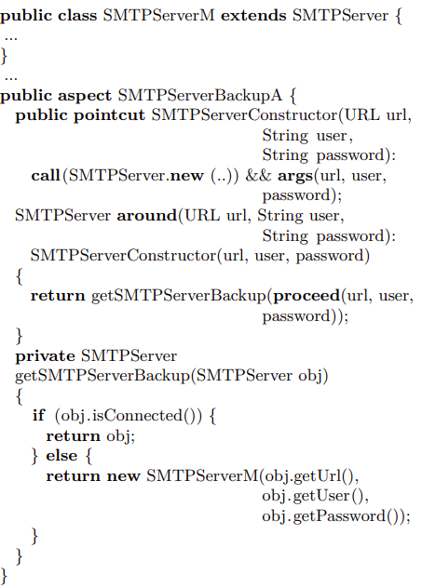
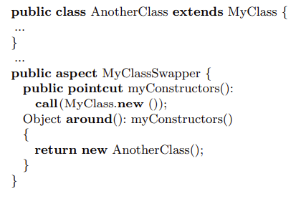
Domain Specific Changes
-returning another SMTP Server instead of original one
using Cuckoo’s egg pattern
Generalization to
Class exchange
change type
Source: Aspect-Oriented Change Realizations and Their Interaction Article V. Vranić, R. Menkyna, M. Bebjak, and P. Dolog. Aspect-Oriented Change Realizations and Their Interaction. e-Informatica Software Engineering Journal, 3(1):43-58, 2009

Slide 40
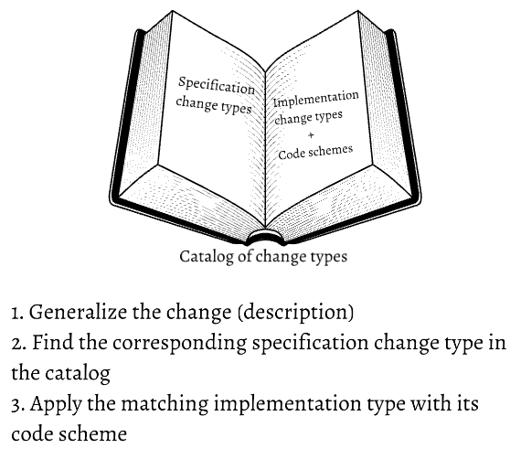
Catalog of Change Types
-to provide developer hints about incorporated changes
MAINTAINING CATALOG OF CHANGES
Source: Aspect-Oriented Change Realizations and Their Interaction Article V. Vranić, R. Menkyna, M. Bebjak, and P. Dolog. Aspect-Oriented Change Realizations and Their Interaction. e-Informatica Software Engineering Journal, 3(1):43-58, 2009

Slide 41
Domain Specific Changes
-returning another SMTP Server
instead of original one using Cuckoo’s
egg pattern
Generalization to Class exchange change type
Source: Aspect-Oriented Change Realizations and Their Interaction Article V. Vranić, R. Menkyna, M. Bebjak, and P. Dolog. Aspect-Oriented Change Realizations and Their Interaction. e-Informatica Software Engineering Journal, 3(1):43-58, 2009

Slide 42
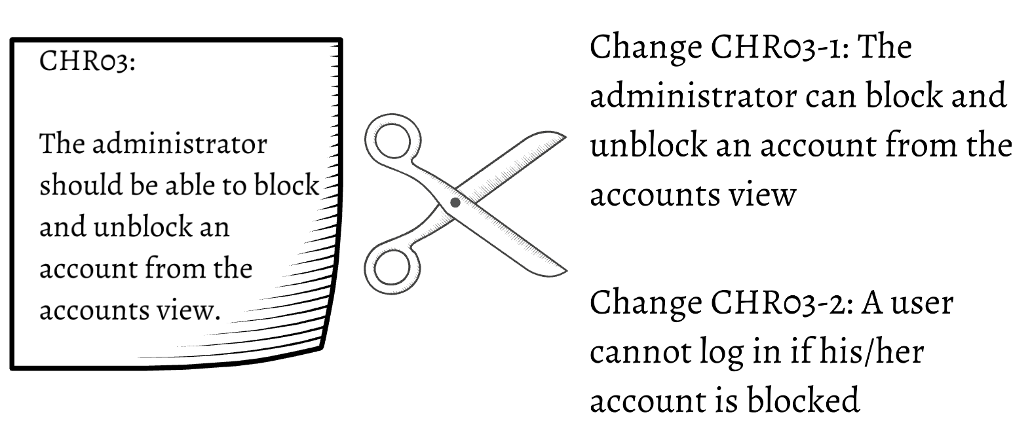
Applying Changes: Example
CHANGE
REQUIREMENTS:
Source: https://poetisania.com/val/

Slide 43
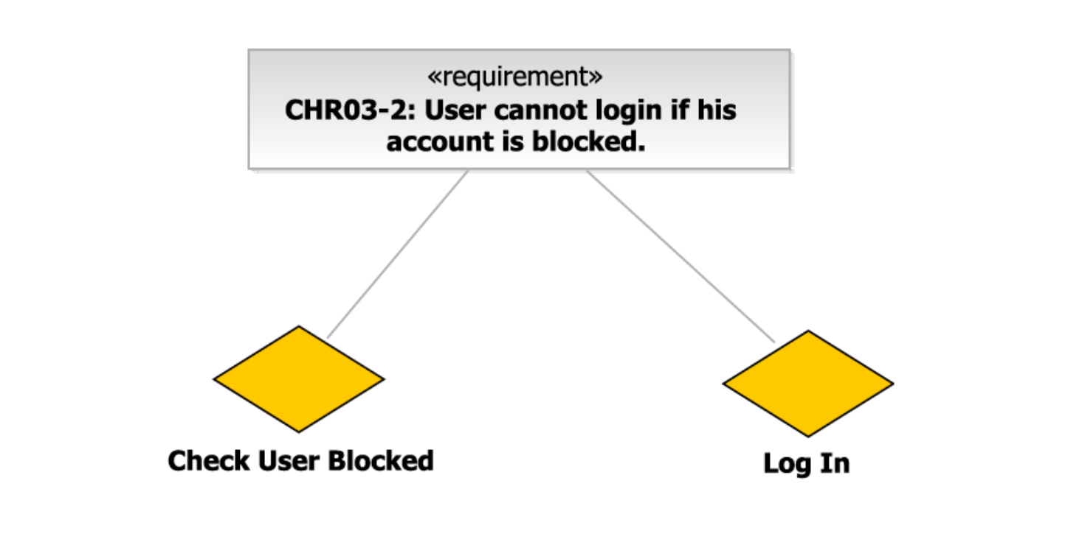
1. Identification of Themes in Change Request
Source: https://poetisania.com/val/

Slide 44
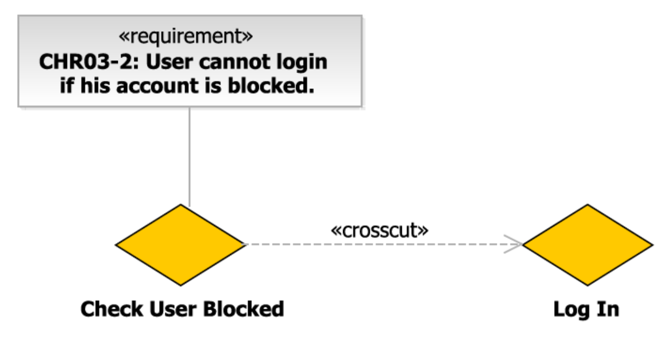
2. Determining Crosscutting Theme
Source: https://poetisania.com/val/

Slide 45
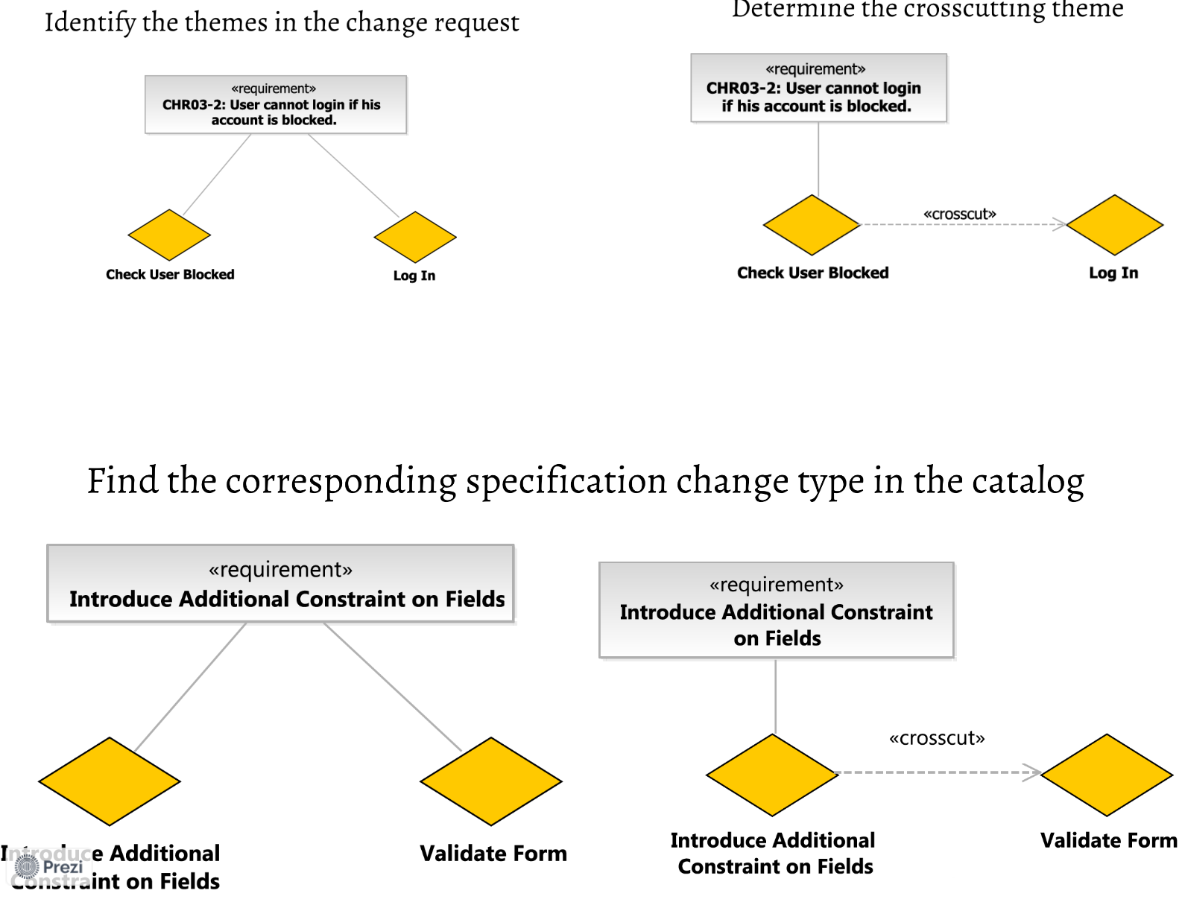
3. Observing Corresponding Specification Change Type in Catalog
Source: https://poetisania.com/val/

Slide 46
Source: https://poetisania.com/val/

Slide 47
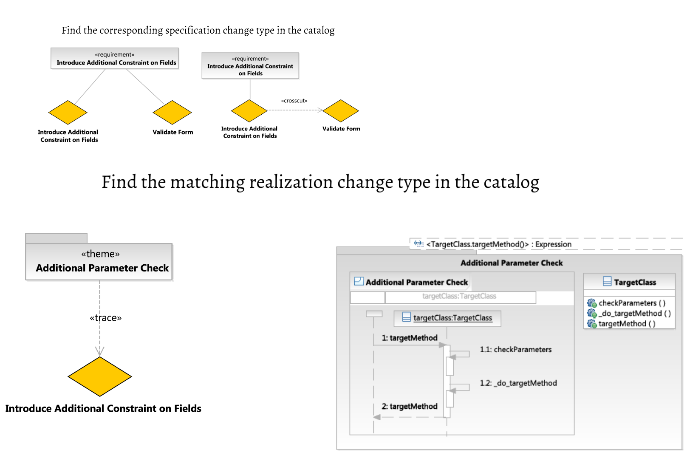
Finding Matching Realization Change in Catalog
Source: https://poetisania.com/val/

Slide 48
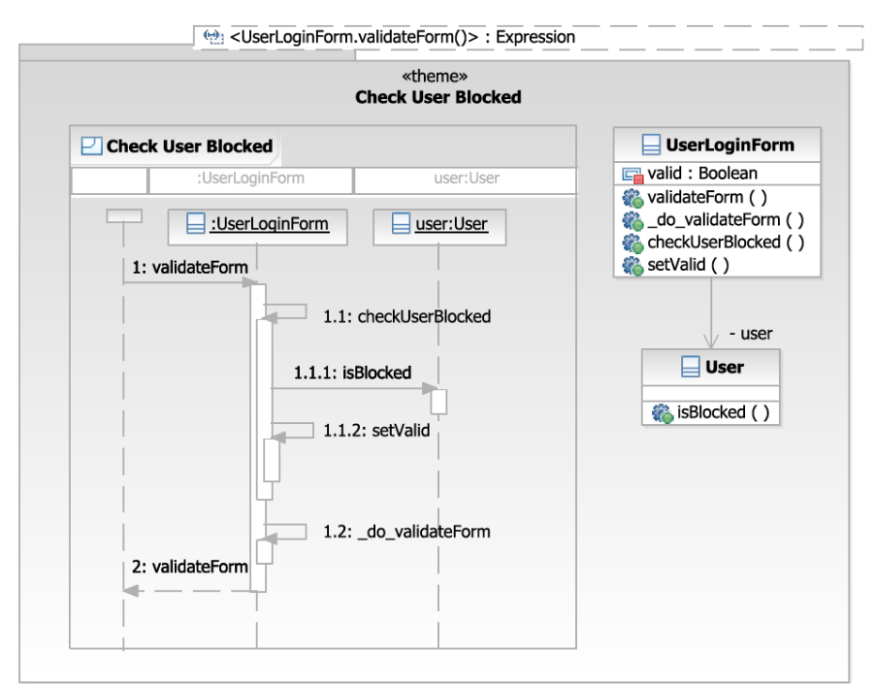
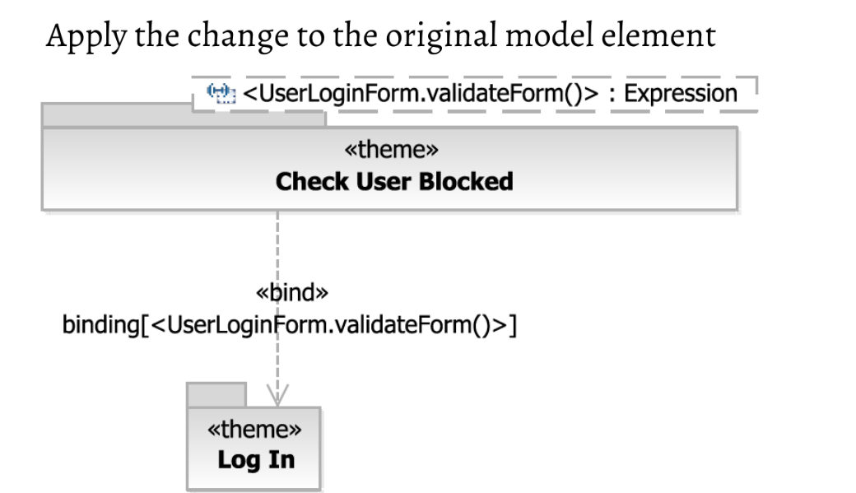

Slide 49
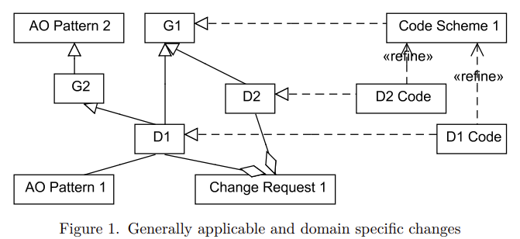
Applying Change Type
6. Introducing Domain independent code scheme for each Generally applicable change
3. Searching and getting Generally applicable change types according to Domain specific types to complete it (G# - G1, G2)
(realization)
4. Introducing
aspects as Generally
applicable change type
(specialization)
7. Incorporating adaptation in the context of Domain specific change usually as kind of refinement
(realization)
2. Indentifying domain
specific changes (D# - D1, D2)
(aggregation)
(association)
5. Introducing
aspects to complete
Domain specific change
Developer chooses
change request
Source: Aspect-Oriented Change Realizations and Their Interaction Article V. Vranić, R. Menkyna, M. Bebjak, and P. Dolog. Aspect-Oriented Change Realizations and Their Interaction. e-Informatica Software Engineering Journal, 3(1):43-58, 2009

Slide 50
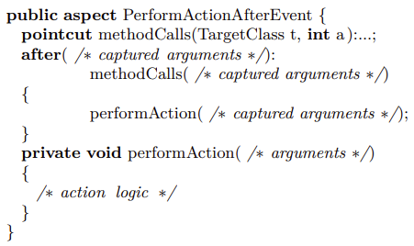
Integration Changes: One Way Integration: Performing Action After Event
such as Notification of incoming events
the integrating application notifies the integrated application of relevant events
Capturing certain events
Performed action after event
Such as a post to the newsletter sign-up/sign-out script and pass it the e-mail address and name of the newly signed-up or deleted affiliate

Slide 51
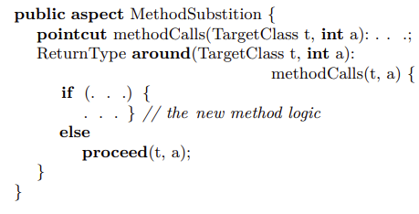
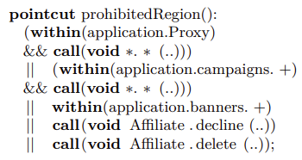
Applied Patterns
Method Substitution
Boudary Control
Souirce: Aspect-Oriented Change Realizations and Their Interaction Article V. Vranić, R. Menkyna, M. Bebjak, and P. Dolog. Aspect-Oriented Change Realizations and Their Interaction. e-Informatica Software Engineering Journal, 3(1):43-58, 2009

Slide 52
Enumeration Modification Change
Introducing new enumeration value:
public aspect NewEnumType {
public static EnumValueType
EnumType.NEWVALUE = new EnumValueType(10, "");
}
Source: Aspect-Oriented Change Realizations and Their Interaction Article V. Vranić, R. Menkyna, M. Bebjak, and P. Dolog. Aspect-Oriented Change Realizations and Their Interaction. e-Informatica Software Engineering Journal, 3(1):43-58, 2009

Slide 53
Changing a Change Using Aspects
-separation of crosscutting concerns in the application
=> IMPROVING MODULARITY
=> MAKES FURTHER CHANGES EASIER
Aspect-oriented
refactoring
1. Use the primitive pointcut to capture execution of all advices:
adviceexecution()
2. Annotating and accessing the advices:
within()/withincode()
Or handling multiple advices by annotating each with the pointcut:
@annotation()

Slide 54
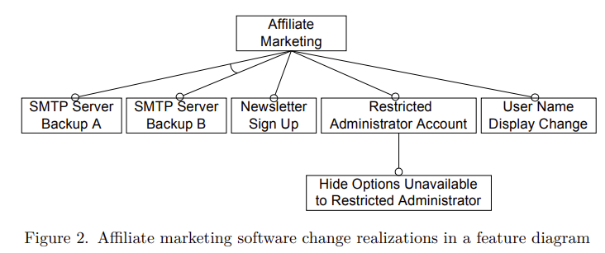
Capturing Change Interactions By Feature Models
Aspect-Oriented Change Realizations and Their Interaction Article V. Vranić, R. Menkyna, M. Bebjak, and P. Dolog. Aspect-Oriented Change Realizations and Their Interaction. e-Informatica Software Engineering Journal, 3(1):43-58, 2009
- Mutual change dependencies of some change realizations
- Dependencies on underlying system affected by other
                change realizations
Possible escalation into a serious problems
FEATURES
-virtually pluggable
as variable features
FEATURE MODELING
Only on will be in resulting system
-variable features are used as the systems extensions
Parent feature must be included
-including variability among changes

Slide 55
Capturing change interactions with a feature diagram…
… Modeling change realizations
-indirect change dependencies may represent indirect change interactions
change realizations as features
affected software concept as feature model
change interaction as each dependency in feature model
Determining if features interact REQUIRES
FURTHER ANALYSIS OF SEMENTICS
Beyond capabilities of feature modeling!

Slide 56
Direct Change Interactions
-affecting common join points
Feature and its subfeatures
Occurs among
alternative
features
- Parent feature must be included
Only one will be in resulting system
Aspect-Oriented Change Realizations and Their Interaction Article V. Vranić, R. Menkyna, M. Bebjak, and P. Dolog. Aspect-Oriented Change Realizations and Their Interaction.
e-Informatica Software Engineering Journal, 3(1):43-58, 2009
Feature model in Czarnecki–Eisenecker basic notation

Slide 57
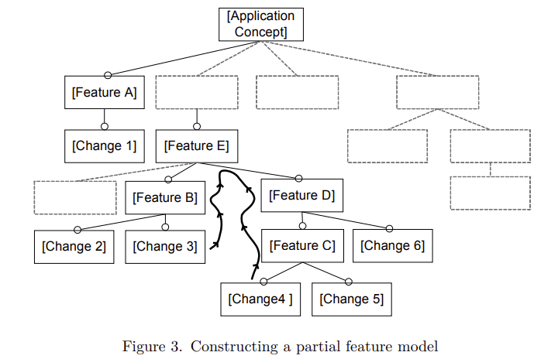
Partial Feature Model Construction
From
Bottom Up
Grouping reached
changes in a
common subtree
-identifying parent
features
Aspect-Oriented Change Realizations and Their Interaction Article V. Vranić, R. Menkyna, M. Bebjak, and P. Dolog. Aspect-Oriented Change Realizations and Their Interaction. e-Informatica Software Engineering
Journal, 3(1):43-58, 2009

Slide 58
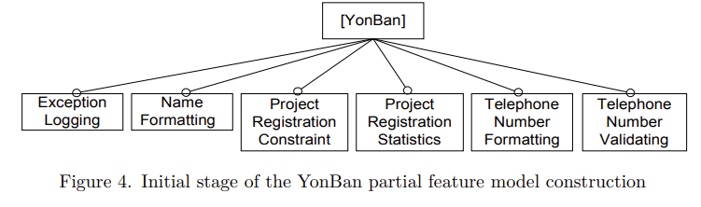
1. Telephone Number Validating (realized as Performing Action After Event): to validate a telephone number the user has entered
2. Telephone Number Formatting (realized as Additional Return Value Checking/Modification): to format a telephone number by adding country prefix
3. Project Registration Statistics (realized as One Way Integration): to gain statistic information about the project registrations
4. Project Registration Constraint (realized as Additional Parameter Checking/Modification): to check whether the student who wants to register a project has a valid e-mail address in his profile
5. Exception Logging (realized as Performing Action After Event): to log the exceptions thrown during the program execution
6. Name Formatting (realized as Method Substitution): to change the way how student names are formatted.
Demonstration:
YonBan
Aspect-Oriented Change Realizations and Their Interaction Article V. Vranić, R. Menkyna, M. Bebjak, and P. Dolog. Aspect-Oriented Change Realizations and Their Interaction. e-Informatica Software Engineering Journal, 3(1):43-58, 2009
Implemented
with aspects:
6.
5.
4.
3.
2.
1.

Slide 59
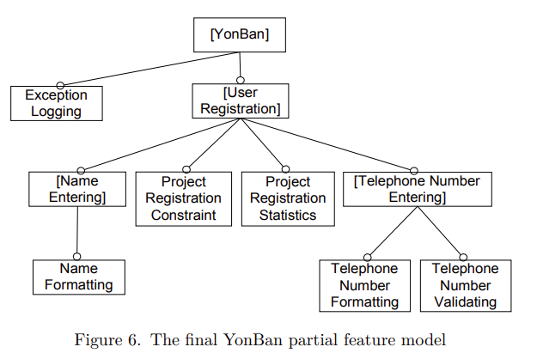
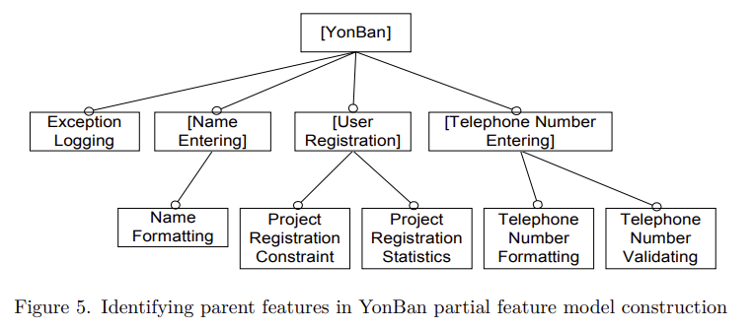
Identifying Parents and
Final Refinement
DEPENDENCIES
DEPENDENCY (OF ENTERING
THE NAME WHILE REGISTERING THE USER)
Open concept of a system (using [])
due to no other specification
Aspect-Oriented Change Realizations and Their Interaction Article V. Vranić, R. Menkyna, M. Bebjak, and P. Dolog. Aspect-Oriented Change Realizations and Their Interaction. e-Informatica Software Engineering Journal, 3(1):43-58, 2009
DEPENDENCY

Slide 60
Resolving Conflicts
The code that implements the parent feature altered by one of the sibling change features can be dependent on the code altered by another sibling change feature or vice versa.
Interdependence of
sibling features –
direct subfeatures the
same parent feature
Aspect
Priority implicit
setting:
call()
vs
execution()
poincuts
Affects user registration
parent feature
Aspect-Oriented Change Realizations and Their Interaction Article V. Vranić, R. Menkyna, M. Bebjak, and P. Dolog. Aspect-Oriented Change Realizations and Their Interaction. e-Informatica Software Engineering Journal, 3(1):43-58, 2009
Resolving dependencies between
aspects by setting priorities to aspects

Slide 61
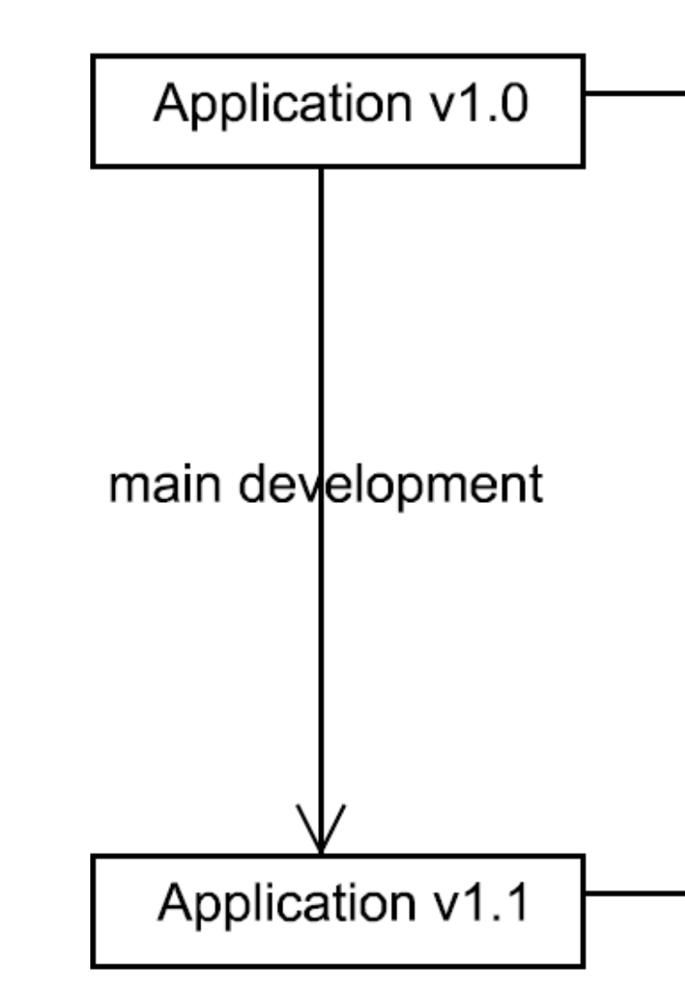
Change Realization
Implementing a
change separately
Directly incorporating
a change to source code
Aspect-Oriented
change realization
Aspect-Oriented Change Realizations and Their Interaction Article V. Vranić, R. Menkyna, M. Bebjak, and P. Dolog. Aspect-Oriented Change Realizations and Their Interaction. e-Informatica Software Engineering Journal, 3(1):43-58, 2009

Slide 62
Aspect-Oriented Change Realization
Aspect-Oriented Change Realizations and Their Interaction Article V. Vranić, R. Menkyna, M. Bebjak, and P. Dolog. Aspect-Oriented Change Realizations and Their Interaction. e-Informatica Software Engineering Journal, 3(1):43-58, 2009

Slide 63
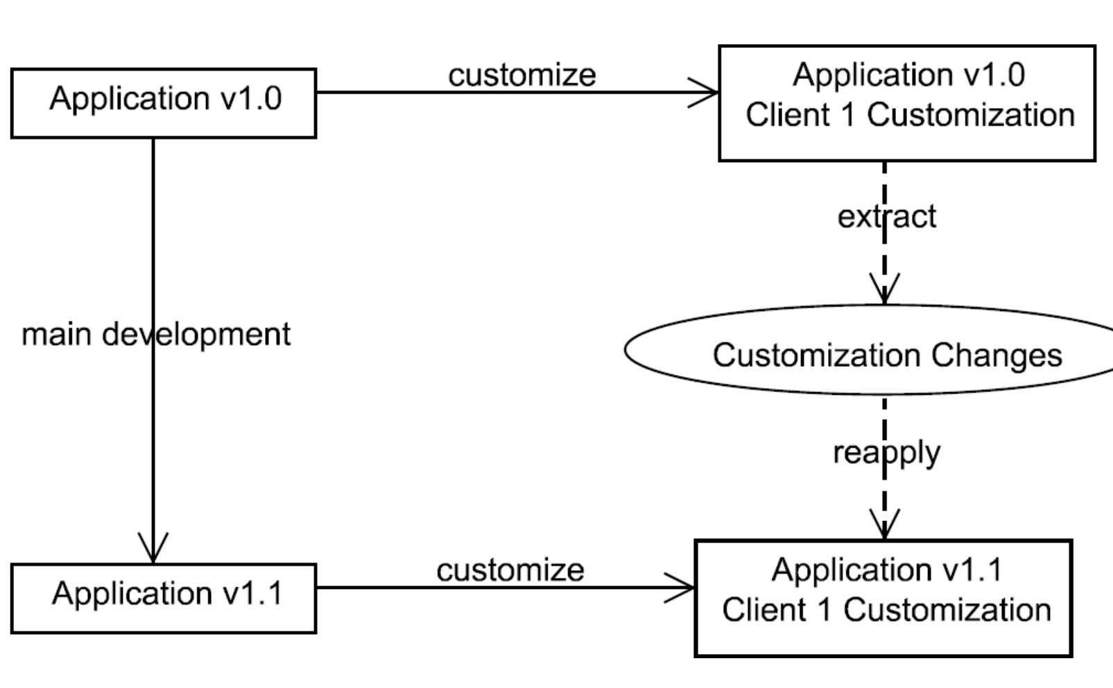
Source: Vranić, Valentino. (2010).
Aspect-Oriented Change Realization

Slide 64
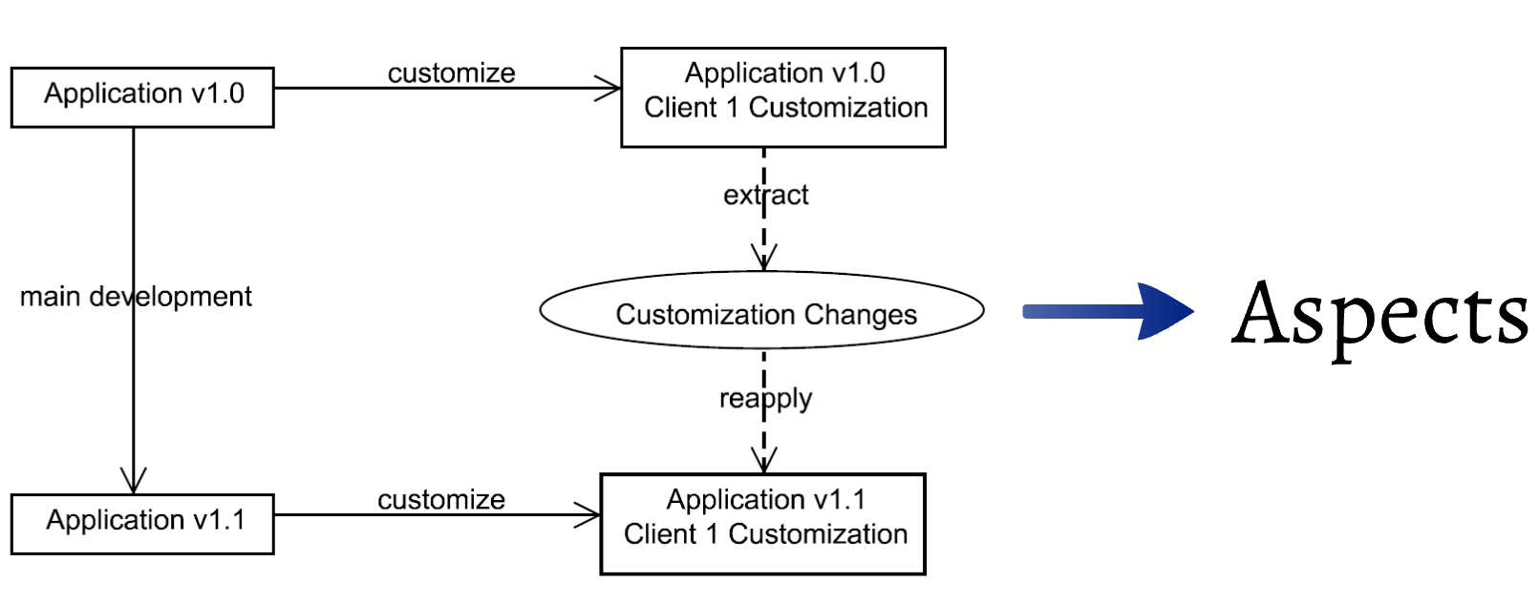
Source: Aspect-Oriented Change Realizations and Their Interaction Article V. Vranić, R. Menkyna, M. Bebjak,
and P. Dolog. Aspect-Oriented Change Realizations and Their Interaction. e-Informatica Software Engineering Journal, 3(1):43-58, 2009

Slide 65
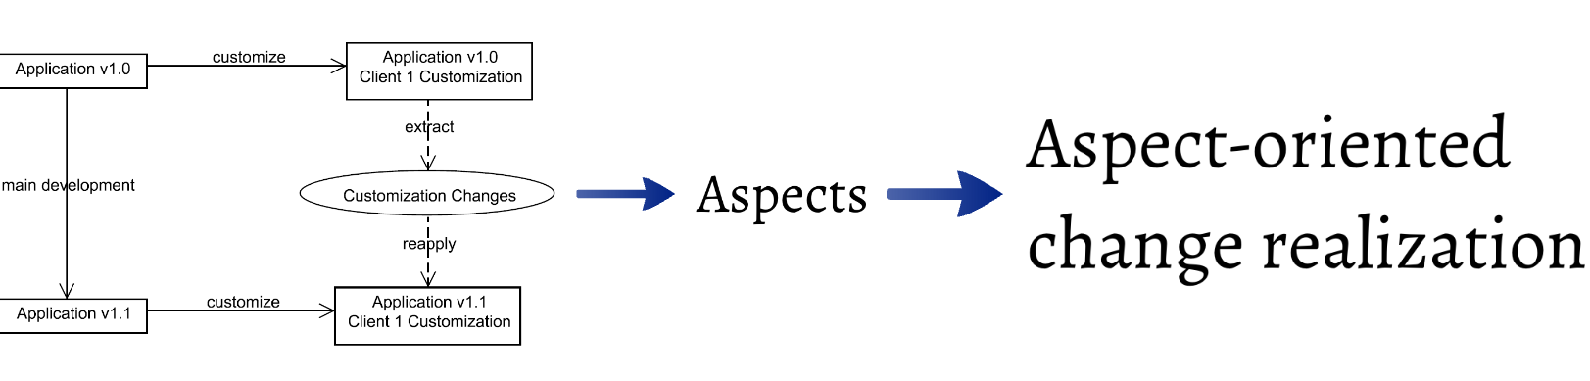
Aspect-Oriented Change Realizations and Their Interaction Article V. Vranić, R. Menkyna, M. Bebjak, and P. Dolog. Aspect-Oriented Change Realizations and Their Interaction. e-Informatica Software Engineering Journal, 3(1):43-58, 2009

Slide 66
References
Trygve Reenskaug and James O. Coplien: The DCI Architecture: A New Vision of Object-Oriented Programming March 20, 2009
Savkin: Data Context Interaction: The Evolution of the Object Oriented Paradigm
Perdek, Jakub, and Valentino, Vranić. "Lightweight Aspect-Oriented Software Product Lines with Automated Product Derivation." In New Trends in Database and Information Systems (pp. 499–510). Springer Nature Switzerland, 2023.
FIGUEIREDO, Eduardo, Nelio CACHO, Claudio SANT’ANNA, Mario MONTEIRO, Uira KULESZA, Alessandro GARCIA, Sergio SOARES, Fabiano FERRARI, Safoora KHAN, Fernando FILHO a Francisco DANTAS, Evolving Software Product Lines with Aspects: An Empirical Study on Design Stability. 2008, s. 10.
JACOBSON, Ivar, Martin GRISS a Patrik JONSSON, 1997. Software Reuse: Architecture, Process and Organization for Business Success. USA: ACM Press/Addison-Wesley Publishing Co. ISBN 0-201-92476-5.
KOHUT, Jan a Valentino VRANIC, Guidelines for using aspects in product lines: 2010 IEEE 8th International Symposium on Applied Machine Intelligence and Informatics (SAMI) [online]. Herlany: IEEE, s. 183–188 [cit. 30.9.2021]. ISBN 978-1-4244-6422-7. Dostupné na: doi:10.1109/SAMI.2010.5423741
Developing Applications with Aspect-Oriented Change Realization: Article Valentino Vranić, Michal Bebjak, Radoslav Menkyna, and Peter Dolog. Developing Applications with Aspect-Oriented Change Realization. In Proceedings of 3rd IFIP TC2 Central and East European Conference on Software Engineering Techniques, CEE-SET 2008, Revised Selected Papers, LNCS 4980, October 2008, Brno, Czech Republic, Springer, 2011
Aspect-Oriented Change Realization Based on Multi-Paradigm Design with Feature Modeling Article Radoslav Menkyna and Valentino Vranić. Aspect-Oriented Change Realization Based on Multi-Paradigm Design with Feature Modeling. In Proceedings of 4th IFIP TC2 Central and East European Conference on Software Engineering Techniques, CEE-SET 2009, Revised Selected Papers, LNCS 7054, October 2009, Krakow, Poland, Springer, 2012.
Aspect-Oriented Change Realizations and Their Interaction Article V. Vranić, R. Menkyna, M. Bebjak, and P. Dolog. Aspect-Oriented Change Realizations and Their Interaction. e-Informatica Software Engineering Journal, 3(1):43-58, 2009

